Slide 1

Quantum Key Distribution with BB84
By @QuantumCheap

Slide 2
Quantum Key Distribution
is a secure communication method which implements a cryptographic protocol involving components of quantum mechanics
There’s an inherent ability for the two communicators to detect the presence of an eavesdropper (since measuring a quantum system disturbs the system)
BB84
developed by Charles Bennett and Gilles Brassard in 1984
It is the first quantum cryptography protocol
It is usually explained as a method of securely communicating a private key from one party to another for use in one-time pad encryption.

Slide 3
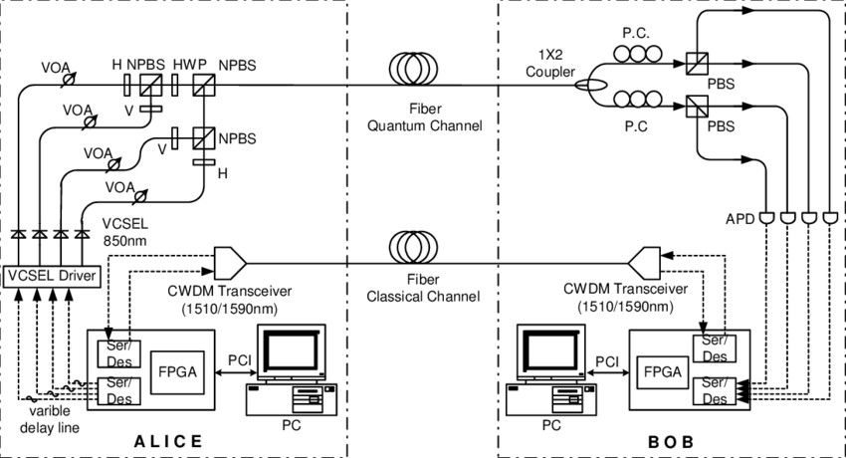
The Setup

Slide 4

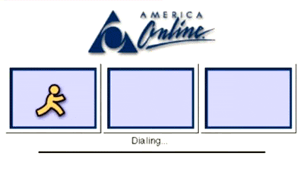

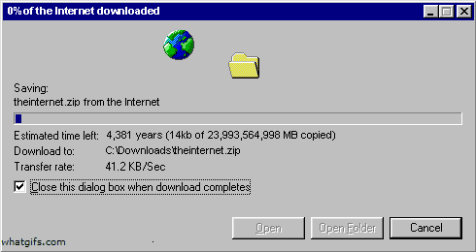

The Setup – Classic Channel

Slide 5
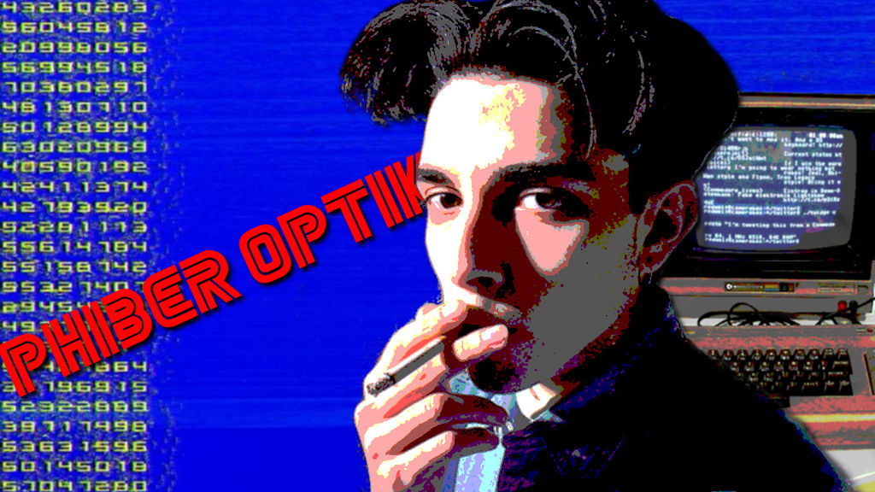
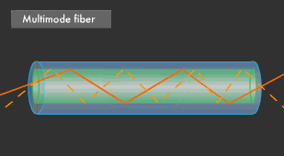
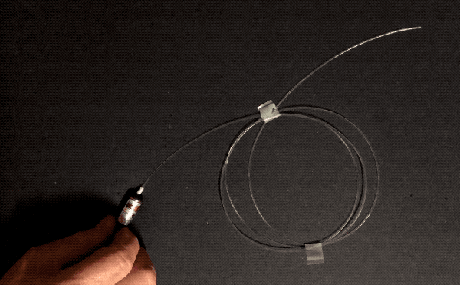
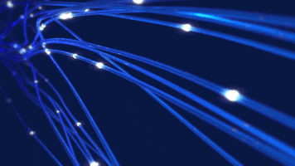
The Setup – Quantum Channel

Slide 6


The Setup – Quantum Channel
1
0
Measurement Basis
Rectilinear
Diagonal

Slide 7
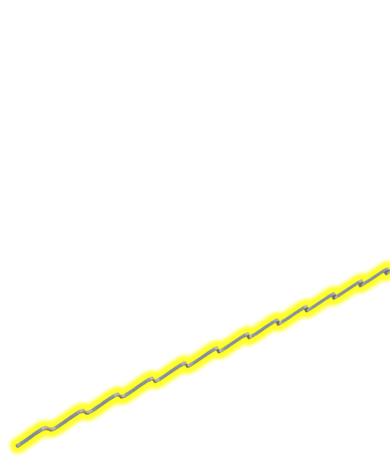
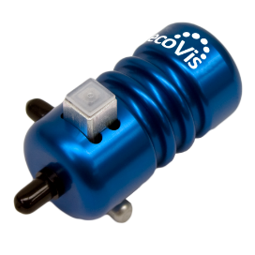
The Setup – Quantum Channel
1
0
Alice has two pairs or polarizers to send photons through. Each pair are perpendicular to each other (0° and 90°) and (45° and 135°).
single-photon light source

Slide 8
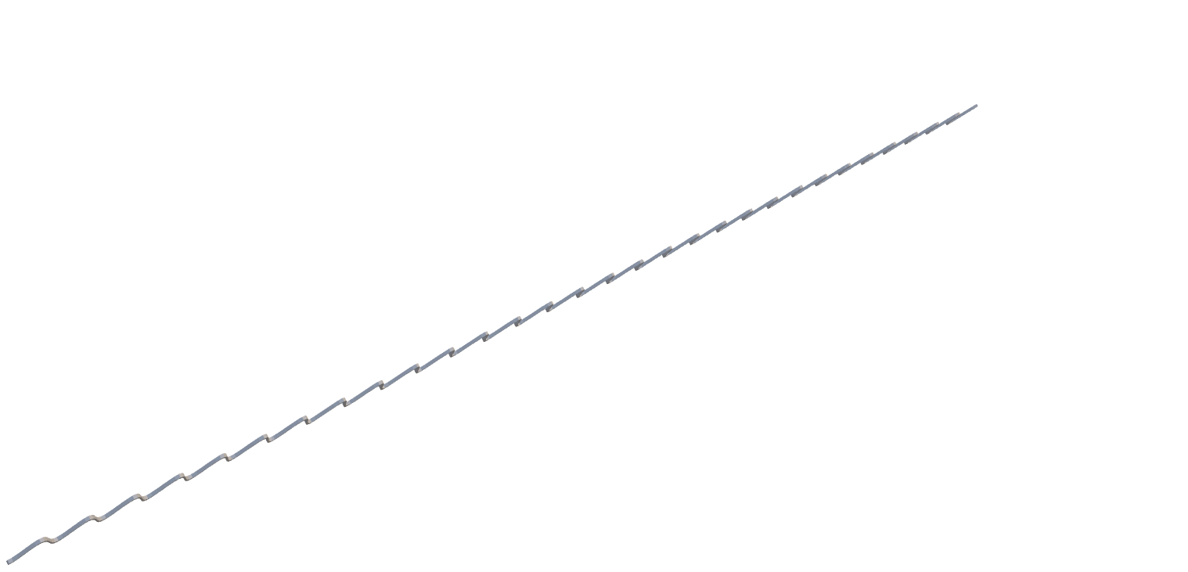
The Setup – Quantum Channel
Measurement Basis
Bob measures the polarization of the photons with two special polarizers. There is a rectilinear polarizer (0° and 90°) and a diagonal polarizer (45° and 135°).
Rectilinear
Diagonal
The receiver randomly selects which bases to measure each photon.

Slide 9
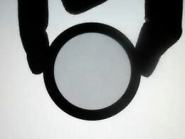
Polarization Demo
0° rotation
100%
pass-through
45° rotation
50%
pass-through
90° rotation
0%
pass-through

Slide 10
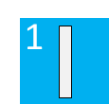



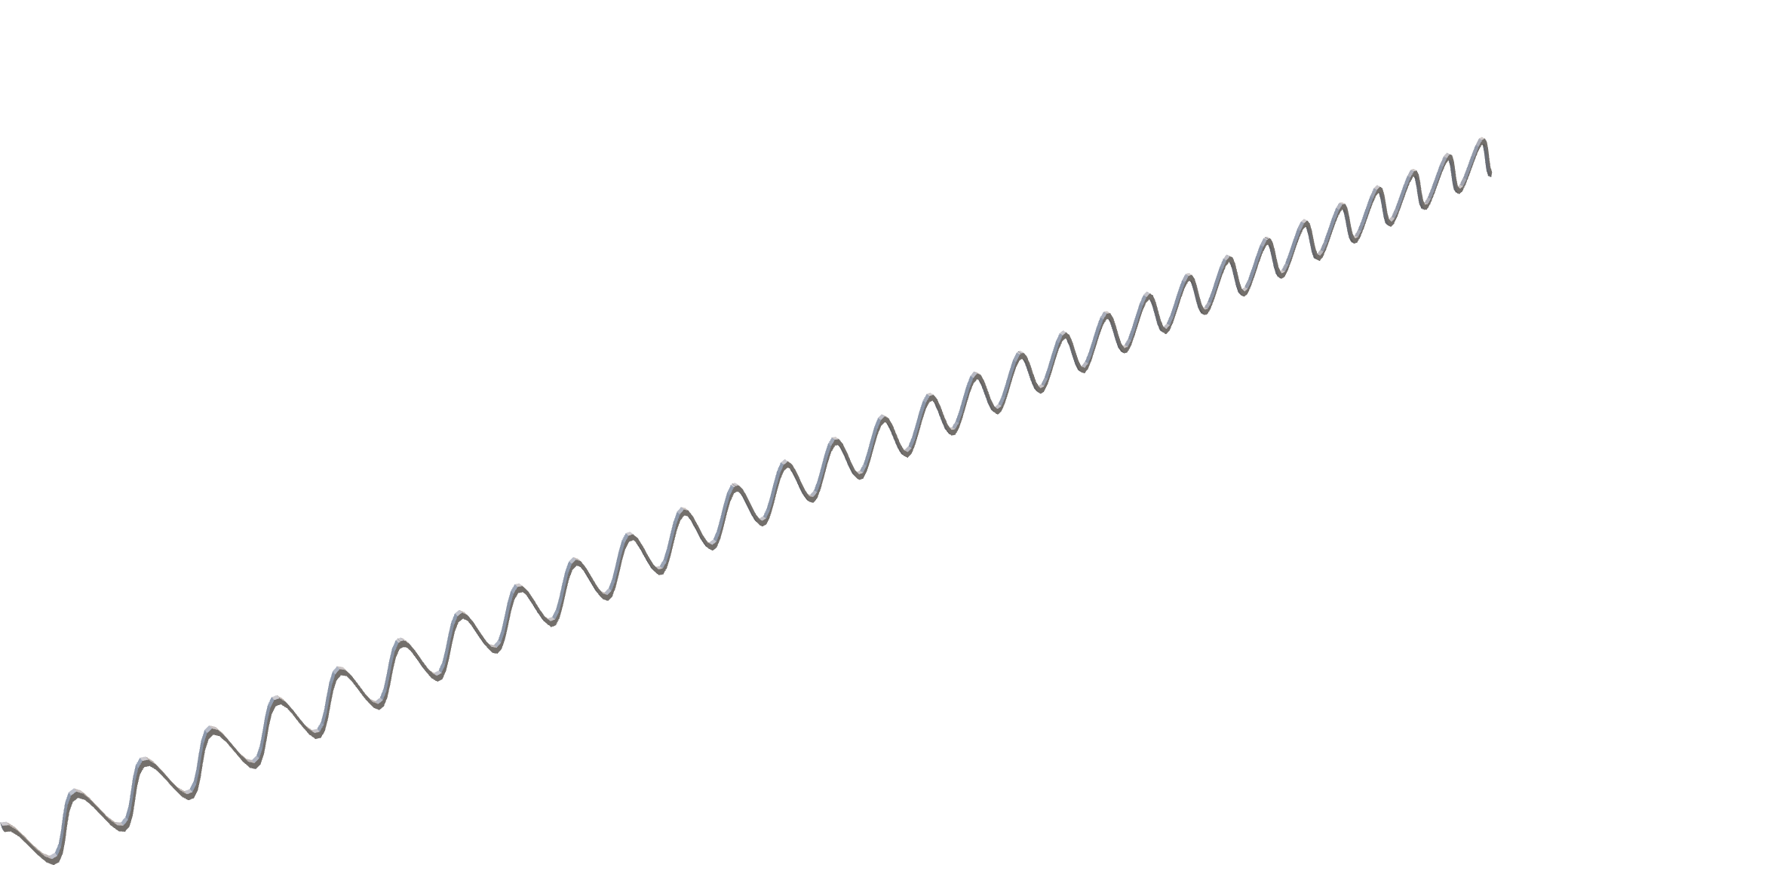
Photon polarization Alice sends
Bob's random measuring basis
Photon polarization Bob measures
1
0
1
0
single-photon light source

Slide 11
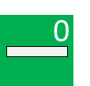




Photon polarization Alice sends
Bob's random measuring basis
Photon polarization Bob measures
1
0
1
0
single-photon light source

Slide 12



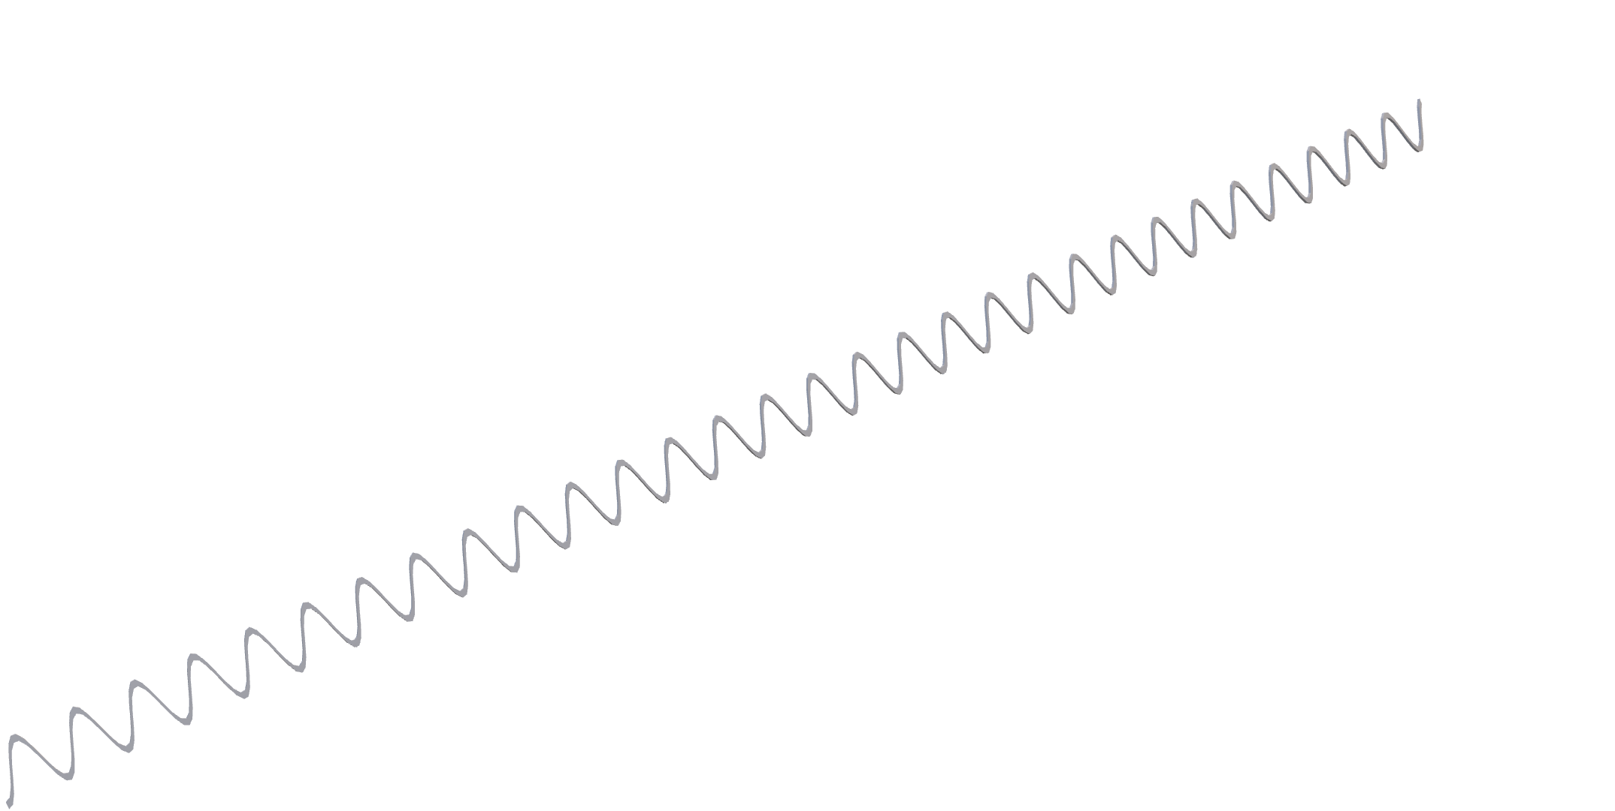
Photon polarization Alice sends
Bob's random measuring basis
Photon polarization Bob measures
1
0
1
0
single-photon light source

Slide 13


Photon polarization Alice sends
Bob's random measuring basis
Photon polarization Bob measures
1
0
1
0
single-photon light source

Slide 14


Photon polarization Alice sends
Bob's random measuring basis
Photon polarization Bob measures
1
0
1
0
single-photon light source

Slide 15



Photon polarization Alice sends
Bob's random measuring basis
Photon polarization Bob measures
1
0
1
0
single-photon light source

Slide 16
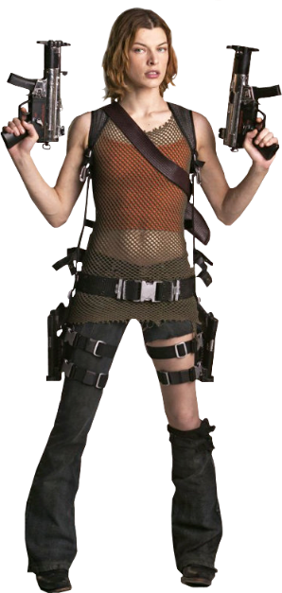

Photon polarization Alice sends
Bob's random measuring basis
Photon polarization Bob measures
1
0
1
0
single-photon light source

Slide 17

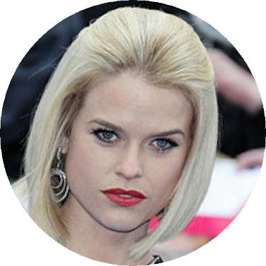
Photon polarization Alice sends
Bob's random measuring basis
Photon polarization Bob measures
1
0
1
0
single-photon light source

Slide 18


Back on the classic channel… Bob and Alice compare which basis they used to send and receive each qubit
Photon polarization Alice sends
Alice’s sending basis
Bob's random measuring basis
Photon polarization Bob measures
PUBLIS DISCUSSION OF BASIS
Shared secret key
The bits corresponding to matching basises become the key!
Key = “1010”

Slide 19
Why Does This Work?

Slide 20


Mission accomplished?

